Slide 1
Operating system
Part IV: CPU Scheduling algorithms
By KONG LingBo (孔令波)

Slide 2
Goals
To know the mechanism of CPU scheduling
Basic Concepts, Criteria
CPU scheduling Algorithms
FCFS, SJF (Non-Preemptive), SRJF (Preemptive), Priority, Round Robin, Multilevel Queue, Multilevel Feedback Queue, Lottery etc.
Algorithms Evaluation
How to simulate and evaluate those CPU scheduling algorithms

Slide 3
Overview of OS
Program
Process
Abstract Computing Environment
File
Manager
Deadlock
Process
Description
Protection
Synchronization
Device
Manager
Memory
Manager
Resource
Manager
(CPU)Scheduler
Resource
Manager
Resource
Manager
Devices
Memory
CPU
Other H/W

Slide 4


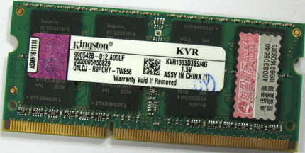
Three kinds of schedulers
Main Memory
Storage media
(Magnetic disk)
CPU
Short-term scheduler determines which processes could get the usage of CPU

Slide 5
CPU Scheduling
Basic Concepts
CPU and some IO devices could work in parallel
Process could be categorized into IO-burst and CPU burst types
Scheduling Criteria & Metrics
Different Scheduling Algorithms
Algorithm Evaluation

Slide 6
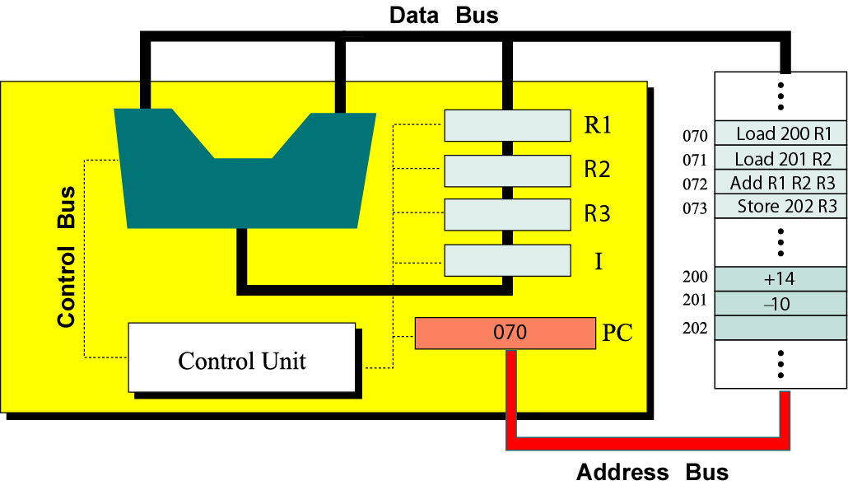
We have learned
CPU is the most important resource
Its job is to execute the instructions following Machine Cycle

Slide 7
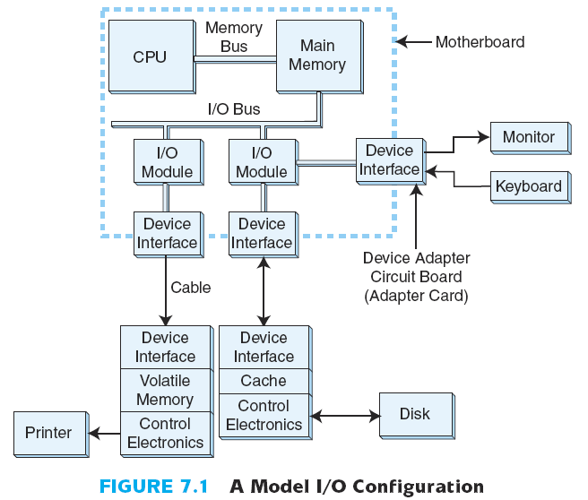
Now
CPU and IO can work in parallel
CPU now focuses on the computation
IO chipsets take over the IO tasks
[2003.Essentials Of Computer Organization And Architecture+++++.pdf]
We’ll learn the framework to manage ID devices in later IO chapter

Slide 8
Now
Traditionally
CPU has to manage everything, including IO operations
Now
CPU and IO work in parallel with the support of Interrupt
CPU is waiting
CPU is waiting
This can make the execution of processes/Threads efficiently!
CPU
IO
CPU and IO ideally work in parallel
Execution timeline
CPU is waiting
CPU
IO
Execution timeline

Slide 9
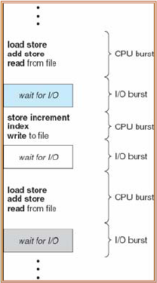
Process’s property: CPU-I/O Burst [突发, 爆发] Cycle
Process execution consists of a cycle of CPU execution and I/O request
Process execution begins with a CPU burst and followed by an I/O burst
PPTs from others\www.cs.gsu.edu_~cscbecx\csc4320 Chapter 5-1.ppt

Slide 10
CPU-I/O Burst
Burst/Service time = total processor time needed in one CPU-I/O burst cycle.
Jobs/Process with long CPU burst time are CPU-bound jobs/processes and are also referred to as “long jobs/processes”.
Jobs with short CPU burst time are IO-bound jobs/processes and are also referred to as “short jobs/processes”.
CPU-bound processes have longer CPU bursts than I/O-bound processes.
PPTs from others\From Ariel J. Frank\OS381\os9-1_cpu.ppt

Slide 11
CPU Scheduling
Basic Concepts
Scheduling Criteria & Metrics
Different Scheduling Algorithms
Algorithm Evaluation

Slide 12
Parameters to evaluate the scheduling
CPU utilization [CPU使用率] (Efficiency)
keep the CPU as busy as possible (from 0% to 100%)
Fairness: each process gets a “fair share” of the CPU
Throughput [吞吐量]
# of processes that complete their execution per time unit
Turnaround time [周转时间]
amount of time to execute a particular Process
i.e. execution time + waiting time
Waiting time [等待时间]
amount of time a process has been waiting in the ready queue
Response time [响应时间]
amount of time it takes from when a request was submitted until the first response is produced , not output (for time-sharing environment)
PPTs from others\www.cs.gsu.edu_~cscbecx\csc4320 Chapter 5-1.ppt

Slide 13
CPU utilization
CPU
other
Execution timeline
0
10
40
70
75
100
CPU Utilization
= (10 + 30 + 25)/100
= 65%

Slide 14
Turnaround time & Waiting time of a process
Two values you should compute in your experiments
Terminated
Created
Process
In ready
Execution timeline
0
10
40
70
75
100
Turnaround time (tt_{i})
= 100
Waiting time (wt_{i})
= 30 + 5
= 35
Average Turnaround time (att)
=
Average Waiting time (awt)
=

Slide 15
Goals for a Scheduler
Suppose we have processes A, B, and C, submitted at time 0
We want to know the response time, waiting time, and turnaround time of process A
turnaround time
wait time
+
+
response time = 0
A
B
C
A
B
C
A
C
A
C
Time

Slide 16
Goals for a Scheduler
Suppose we have processes A, B, and C, submitted at time 0
We want to know the response time, waiting time, and turnaround time of process B
turnaround time
wait time
+
response time
A
B
C
A
B
C
A
C
A
C
Time

Slide 17
Goals for a Scheduler
Suppose we have processes A, B, and C, submitted at time 0
We want to know the response time, waiting time, and turnaround time of process C
turnaround time
wait time
+
+
+
response time
A
B
C
A
B
C
A
C
A
C
Time

Slide 18
You can derive the Optimization Criteria
To maximize or minimize some average measures:
Max CPU utilization
Fraction of the time the CPU isn’t idle
Max throughput
Amount of “useful work” done per time unit
Min turnaround time
Time from process creation to process completion
Min waiting time
Amount of time a process spends in the WAITING state
Min Response time
PPTs from others\OS PPT in English\ch06.ppt
PPTs from others\www.cs.gsu.edu_~cscbecx\csc4320 Chapter 5-1.ppt

Slide 19
Preemptive vs. non-preemptive scheduling —抢占式 v.s 非抢占式 调度
Non-preemptive(not forcible removable):
Once a process is in the running state, it will continue until it terminates or blocks itself for I/O.
Preemptive (forcible removable) :
Currently running process may be interrupted and moved to the Ready state by the OS.
processes can be suspended by scheduler
incurs a cost associated with access to share data.

Slide 20
Scheduling Algorithms
First Come First Serve Scheduling [先来先服务] (Non-preemptive)
Shortest Job First Scheduling [最短任务先服务]
SRTF (Shortest Remaining Time First Scheduling)/SRJF
Priority Scheduling [优先权]
Round-Robin Scheduling [时间片轮转]
Multilevel Queue Scheduling [多层次队列]
Multilevel Feedback-Queue Scheduling [多层次反馈队列]
Lottery Scheduling [抽彩]
PPTs from others\www.cs.gsu.edu_~cscbecx\csc4320 Chapter 5-1.ppt

Slide 21
CPU Scheduling
Basic Concepts
Scheduling Criteria & Metrics
Different Scheduling Algorithms
Algorithm Evaluation

Slide 22
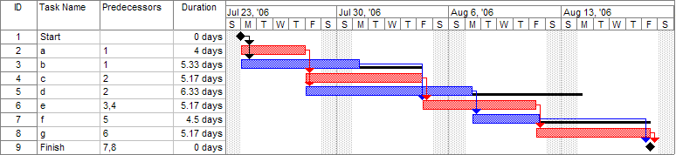
Gantt Chart [甘特表]
http://en.wikipedia.org/wiki/Gantt_chart
A Gantt chart is a type of bar chart, developed by Henry Gantt, that illustrates a project schedule.
Gantt charts illustrate the start and finish dates of the terminal elements and summary elements of a project.
Terminal elements and summary elements comprise the work breakdown structure of the project

Slide 23
FCFS (First Come First Serve) Scheduling
FIFO scheduling
Simplest scheme
Processes dispatched according to arrival time
Non-preemptible/preemptive
Rarely used as primary scheduling algorithm
Or First-In-First-Out (FIFO)

Slide 24
A Simpler FCFS Example
Process Burst Time Arrival time
P₁ 24 1
P₂ 3 4
P₃ 3 6
Suppose the scheduling time now is 10 The Gantt Chart for the schedule is:
Waiting time for P₁ = 9; P₂ = 30; P₃ = 31
Average waiting time: (9 + 30 + 31)/3 = 70/3
Convoy effect [护航效果]: short process behind long process; or short process has to wait the long process to finish.
P₁
P₂
P₃
1/10
4/34
6/37
40

Slide 25
FCFS Drawbacks
A process that does not perform any I/O will monopolize the processor (Convoy Effect).
Favors CPU-bound processes:
I/O-bound processes have to wait until CPU-bound process completes.
They may have to wait even when their I/O are completed (poor device utilization).
We could have kept the I/O devices busy by giving a bit more priority to I/O bound processes.

Slide 26
Shortest Job First (SJF)
Selection function: the process with the shortest expected CPU burst time.
Decision mode: Non-preemptive.
There is a variant which supports “Preemptive”, called SRJF (Shortest-Remaining Job First)
also called Shortest Time First (STF) and Shortest Process Next (SPN).
I/O bound processes will be picked first.
SJF is optimal – gives minimum average waiting time for a given set of processes.
Notes:
[2016年3月18日09:10:21] 是最优的. 但是, 最优也就意味着需要知道未来的信息, 但是, 这是不可能的, 所以, 实际中主要是作为理论模型.

Slide 27
Example of SJF
Process Arrival Time Burst Time
P₁ 0.0 7
P₂ 2.0 4
P₃ 4.0 1
P₄ 5.0 4
SJF (non-preemptive)
Average waiting time = (0 + 6 + 3 + 7)/4 = 4
P₁
P₃
P₂
P₄
0
3
7
8
12
16

Slide 28
Dynamics of Shortest-Job-First (SJF)
Associate with each process the length of its next CPU burst.
Use these lengths to schedule the process with the shortest time.
Non-preemptive – once CPU given to the process it cannot be preempted until completes its CPU burst.
We need to somehow estimate the required processing time (CPU burst time) for each process.

Slide 29
Determining length of next CPU Burst
Can only estimate the length.
Can be done by using the length of previous CPU bursts, using exponential averaging:

Slide 30
Examples of Exponential Averaging
How to set α in
α = 0
τ_{n+1} = τ_{n,}
Recent history does not count.
α = 1
τ_{n+1} = t_{n,}
Only the actual last CPU burst counts.
Let’s be balanced: α = 0.5
– See example in next slide.

Slide 31
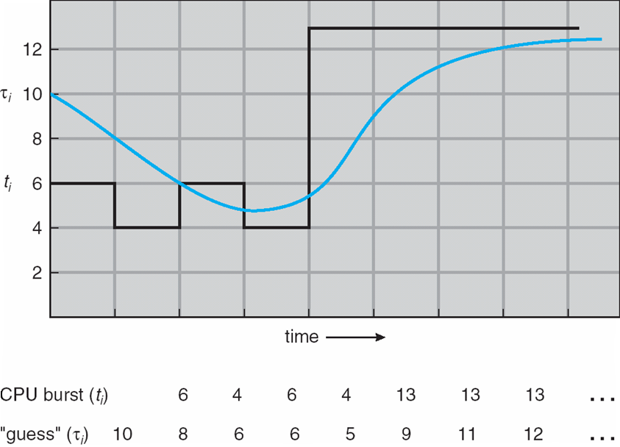
Prediction of the length of the next CPU Burst
Notes:
[2016年3月18日09:12:28]
这跟现实的体验是一样的 – 设计好自己的未来, 你就可能真的达到. 有云: 你只要下定决心, 世界都会为你让路!

Slide 32
Idea of Exponential Averaging [指数平均]
If we expand the formula, we get:
τ_{n+1} = α t_{n}+(1 – α) α t_{n-1} + …
+(1 – α )^{j} α t_{n-j} + …
+(1 – α )^{n+1} τ₀
Since both α and (1 – α) are less than or equal to 1, each successive term has less weight than its predecessor; term weights are decreasing exponentially.
Exponential averaging here is better than simple averaging.
Notes:
这也常用于所谓的时间序列数据分析 (Time Series Data Analysis), 而时间序列数据分析在股票等随时间变化的数据类分析中很常用 – 当下的预测有赖于历史的数据.
τ_{n+1} = α t_{n}+(1 – α) α t_{n-1} + …
+(1 – α )^{j} α t_{n-j} + …
+(1 – α )^{n+1} τ₀
按照上面的公式, 当下的预测为 τ_{n+1} ; 显然, 预测值有赖于t_{n}, t_{n-1} , …, t_{n-j}. 等历史数据, 以及τ₀. 最早的那次预测值.

Slide 33
Shortest Job First Drawbacks
Possibility of starvation for longer processes as long as there is a steady supply of shorter processes.
Lack of preemption is not suited in a time sharing environment:
CPU bound process gets lower priority (as it should) but a process doing no I/O could still monopolize the CPU if he is the first one to enter the system.
SJF implicitly incorporates priorities: shortest jobs are given preferences.

Slide 34
Shortest-Remaining-Job-First (SRJF)
Idea
Associate with each process the length of its next/remaining CPU burst.
Use these lengths to schedule the process with the shortest time.
Preemptive – if a new process arrives with CPU burst length less than remaining time of current executing process, preempt.
Called Shortest-Remaining-Job-First (SRJF).

Slide 35
Example of Preemptive SJF → SRTF
Process Arrival Time Burst Time
P₁ 0.0 7
P₂ 2.0 4
P₃ 4.0 1
P₄ 5.0 4
SJF (preemptive)
Average waiting time = (9 + 1 + 0 +2)/4 = 3
When P₁ is running, and P₂ comes, finishes, now it is time to run P₁ or P₂?
P₁
P₂
P₃
P₂
P₄
P₁
0
2
4
5
7
11
16
PPTs from others\Operating System Concepts 6ed\Slides\ch6.ppt
Notes:
[2016年3月18日09:13:24]
Hint: 在学习 CPU scheduling algorithm 时, 要注意到调度点/时刻 – “新任务到达” 是所有到要考虑的, 和结束

Slide 36
Shortest Remaining Time Scheduling
Preemptive version of SJF/SPN
Shorter arriving processes preempt a running process
Very large variance of response times: long processes wait even longer than under SPF
Not always optimal
Short incoming process can preempt a running process that is near completion
Context-switching overhead can become significant
PPTs from others\www.cs.nmsu.edu_~jinghe_CS474\lect12.ppt

Slide 37
Priority
A priority number (integer) is associated with each process
The CPU is allocated to the process with the highest priority (smallest integer ≡ highest priority).
Preemptive
Non-preemptive
➔ SJF is a priority scheduling where priority is the predicted next CPU burst time.
Problem：
Starvation – low priority processes may never execute.
Solution：
Aging – as time progresses increase the priority of the process.
PPTs from others\Operating System Concepts 6ed\Slides\ch6.ppt
PPTs from others\www.cs.gsu.edu_~cscbecx\csc4320 Chapter 5-1.ppt

Slide 38
Example: Priority scheduling (non-preemptive)
Process Arrive Time Burst Time Priority
P1 0.0 10 3
P2 4.0 1 1
P3 8.0 2 4
P4 9.0 1 5
P5 11.0 5 2
Priority scheduling (non-preemptive)
Waiting time: (0+6+8+9+0)/5 =4.6(ms).
Arrival time
P1
P2
P3
P4
P5
0
4
8
9
11
P1
P2
P5
P3
P4
0
10
11
16
18
19

Slide 39

Example: Priority scheduling (preemptive?)
Process Arrive Time Burst Time Priority
P1 0.0 10 3
P2 4.0 1 1
P3 8.0 2 4
P4 9.0 1 5
P5 11.0 5 2
Priority scheduling (preemptive?)
Waiting time?

Slide 40
Drawback of priority
The main drawback of priority scheduling: starvation!
To avoid:
Prevent high priority processes from running indefinitely by changing priorities dynamically:
Each process has a base priority
increase priorities of waiting processes at each clock tick
Preserving the SJF priority
increase priorities of i/o bound processes
priority = 1/f ( f is the fraction of time-quantum used)

Slide 41
This strategy is used in the later MLFQ (Multilevel Feedback Queue) model.
In fact, FCFS and SJF could be taken as the special instances of priority scheduling
Priority in FCFS is the arrival time
Priority in SJF therefore is the burst time of corresponding processes
The aging strategy can also be used in real life to convenience the customer’s satisfaction
Such as in bank waiting
We can upgrade the priority of the customers who have been waiting too long time

Slide 42
Round-Robin (RR) Scheduling
Round-robin scheduling
Based on FIFO
Processes run only for a limited amount of time called a time slice or quantum
Preemptive
Requires the system to maintain several processes in memory to minimize overhead
Often used as part of more complex algorithms

Slide 43
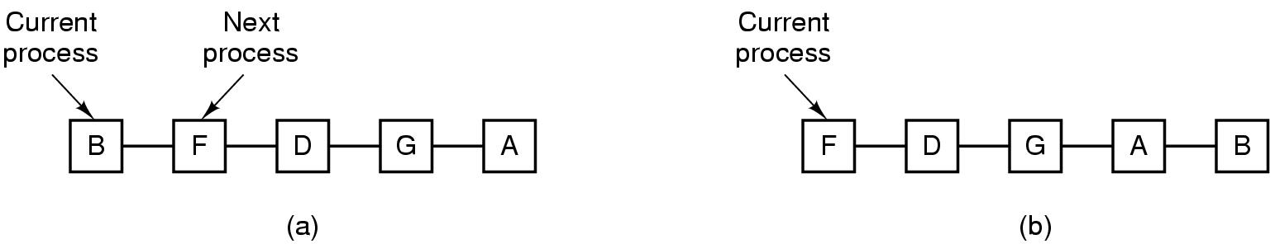
Round-Robin (RR)
Selection function: (initially) same as FCFS.
Decision mode: preemptive –
a process is allowed to run until the time slice period, called time quantum, is reached.
then a clock interrupt occurs and the running process is put at the end of the ready queue.

Slide 44
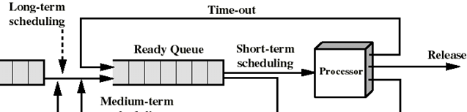
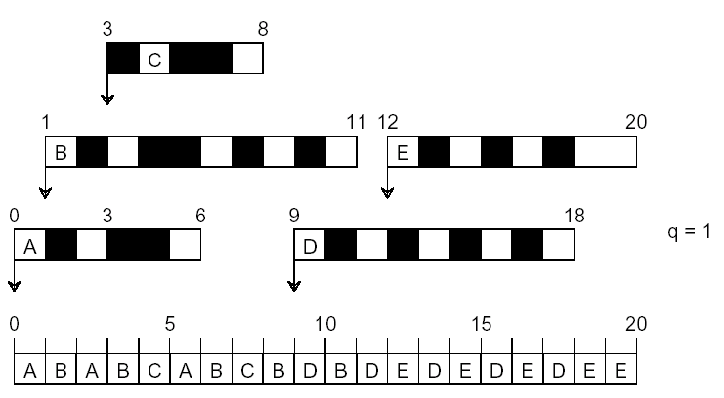
Another RR Example (q = 1)

Slide 45
Picking the Right Quantum
Trade-off:
Short quantum: great response/interactivity but high overhead
Hopefully not too high if the dispatcher is fast enough
Long quantum: poor response/interactivity, but low overhead
With a very long time quantum, RR Scheduling becomes FCFS Scheduling
If context-switching time is 10% of time quantum, then the CPU spends >10% of its time doing context switches
In practice, %CPU time spent on switching is very low
time quantum: 10ms to 100ms
context-switching time: 10μs
PPTs from others\navet.ics.hawaii.edu_~casanova_courses_ics412_fall09\ics412_scheduling.ppt

Slide 46
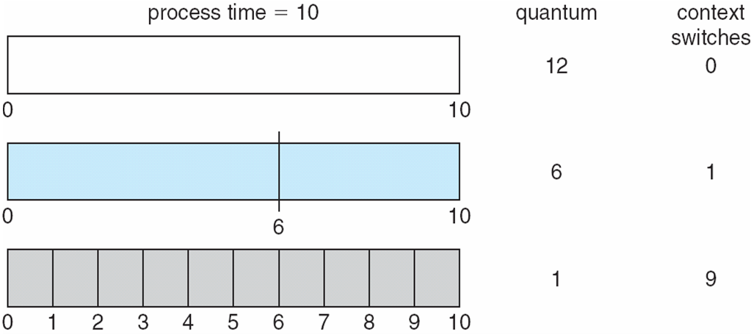
Picking the Right Quantum
PPTs from others\navet.ics.hawaii.edu_~casanova_courses_ics412_fall09\ics412_scheduling.ppt

Slide 47
RR Discussion
Advantages
Jobs get fair share of CPU
Shortest jobs finish relatively quickly
Disadvantages
Poor average waiting time with similar job lengths
Example: 10 jobs each requiring 10 time slices
RR: All complete after about 100 time slices
FCFS performs better!
Performance depends on length of time-slice
If time-slice too short, pay overhead of context switch
If time-slice too long, degenerate to FCFS
PPTs from others\www.cs.uga.edu_~maria_classes4730-Fall-2006\06-scheduling.pdf

Slide 48
Multilevel Queue
The RR Scheduling scheme treats all processes equally
In practice, one often want to classify processes in groups, e.g., based on externally-defined process priorities
Simple idea: use one ready queue per class of processes
e.g., if we support 10 priorities, we maintain 10 ready queues
Scheduling within queues
Each queue has its own scheduling policy
e.g., High-priority could be RR, Low-priority could be FCFS
Scheduling between the queues
Typically preemptive priority scheduling
A process can run only if all higher-priority queues are empty
Or time-slicing among queues
e.g., 80% to Queue #1 and 20% to Queue #2
PPTs from others\navet.ics.hawaii.edu_~casanova_courses_ics412_fall09\ics412_scheduling.ppt

Slide 49
Example of Multilevel Queue
Ready queue is partitioned into separate queues:
foreground (interactive)
background (batch)
Each queue has its own scheduling algorithm,
foreground – RR
background – FCFS
Scheduling must be done between the queues.
Fixed priority scheduling; (i.e., serve all from foreground then from background). Possibility of starvation.
Time slice – each queue gets a certain amount of CPU time which it can schedule amongst its processes; i.e.,
80% to foreground in RR
20% to background in FCFS
PPTs from others\Operating System Concepts 6ed\Slides\ch6.ppt

Slide 50
Multi-Level Queue Scheduling
Highest priority
system processes
interactive processes
Interactive editing processes
batch processes
student processes
Lowest priority
PPTs from others\www.cs.bgu.ac.il\Scheduling.ppt

Slide 51
Multilevel Feedback Queue
Processes can move among the queues
If queues are defined on internal process characteristics, it makes sense to move a process whose characteristics have changed
e.g., based on CPU burst length
It’s also a good way to implement priority aging

Slide 52
Example of Multilevel Feedback Queue
Three queues:
Q₀ – RR with time quantum 8 milliseconds
Q₁ – RR time quantum 16 milliseconds
Q₂ – FCFS
Scheduling
A new job enters queue Q₀ which is served FCFS. When it gains CPU, job receives 8 milliseconds. If it does not finish in 8 milliseconds, job is moved to queue Q₁.
At Q₁, job is again served FCFS and receives 16 additional milliseconds. If it still does not complete, it is preempted and moved to queue Q₂.
PPTs from others\www.cs.gsu.edu_~cscbecx\csc4320 Chapter 5-1.ppt

Slide 53
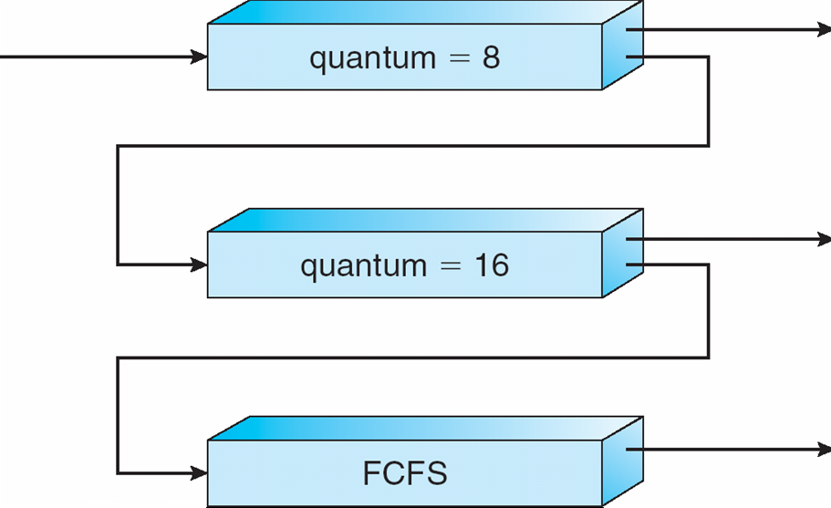
Example of Multilevel Feedback Queue
Q0: RR (q=8)
high
across-queue
priority
Q1: RR (q=16)
Q2: FCFS
low
PPTs from others\www.cs.gsu.edu_~cscbecx\csc4320 Chapter 5-1.ppt

Slide 54
Multilevel Feedback Queues
time = 0
2
3
4
Priority 0 (time slice = 1):
Priority 1 (time slice = 2):
Priority 2 (time slice = 4):
A
B
C
Time

Slide 55
Multilevel Feedback Queues
time = 1
Priority 0 (time slice = 1):
Priority 1 (time slice = 2):
Priority 2 (time slice = 4):
B
C
A
A
Time

Slide 56
Multilevel Feedback Queues
time = 2
Priority 0 (time slice = 1):
Priority 1 (time slice = 2):
Priority 2 (time slice = 4):
C
A
B
A
B
Time

Slide 57
Multilevel Feedback Queues
time = 3
Priority 0 (time slice = 1):
Priority 1 (time slice = 2):
Priority 2 (time slice = 4):
A
B
C
A
B
C
Time

Slide 58
Multilevel Feedback Queues
time = 3
Priority 0 (time slice = 1):
Priority 1 (time slice = 2):
Priority 2 (time slice = 4):
A
B
C
suppose process A is blocked on an I/O
A
B
C
Time

Slide 59
Multilevel Feedback Queues
time = 3
Priority 0 (time slice = 1):
Priority 1 (time slice = 2):
Priority 2 (time slice = 4):
A
B
C
suppose process A is blocked on an I/O
A
B
C
Time

Slide 60
Multilevel Feedback Queues
time = 5
Priority 0 (time slice = 1):
Priority 1 (time slice = 2):
Priority 2 (time slice = 4):
A
C
suppose process A is returned from an I/O
A
B
C
B
Time

Slide 61
Multilevel Feedback Queues
time = 6
Priority 0 (time slice = 1):
Priority 1 (time slice = 2):
Priority 2 (time slice = 4):
C
A
B
C
B
A
Time

Slide 62
Multilevel Feedback Queues
time = 8
Priority 0 (time slice = 1):
Priority 1 (time slice = 2):
Priority 2 (time slice = 4):
C
A
B
C
B
A
C
Time

Slide 63
Multilevel Feedback Queues
time = 9
Priority 0 (time slice = 1):
Priority 1 (time slice = 2):
Priority 2 (time slice = 4):
A
B
C
B
A
C
C
Time

Slide 64
CPU Scheduling
Basic Concepts
Scheduling Criteria & Metrics
Different Scheduling Algorithms
Algorithm Evaluation

Slide 65
Algorithms Comparison
Which one is best?
The answer depends on:
on the system workload (extremely variable).
hardware support for the dispatcher.
relative weighting of performance criteria (response time, CPU utilization, throughput...).
The evaluation method used (each has its limitations...).
Hence the answer depends on too many factors to give any...
PPTs from others\From Ariel J. Frank\OS381\os9-2_cpu.ppt

Slide 66
Deterministic modeling
Deterministic modeling [确定模型法] takes a particular predetermined workload and defines the performance of each algorithm for that workload.
To describe scheduling algorithms and provide examples,
Deterministic model is simple and fast. It gives the exact numbers, allowing us to compare the algorithms.
However, it requires exact numbers for input, and its answers apply only to these cases.
PPTs from others\OS PPT in English\ch06.ppt

Slide 67
Simulations
Simulations [模拟] involve programming a model of the computer system.
Software data structures represent the major components of the system.
The simulator has a variable representing a clock; as this variable’s value is increased, the simulator modifies the system to reflect the activities of the device, the processes, and the scheduler.
As the simulation executes, statistics that indicate algorithm performance are gathered and printed.
Artificial data or trace tapes.
PPTs from others\OS PPT in English\ch06.ppt

Slide 68
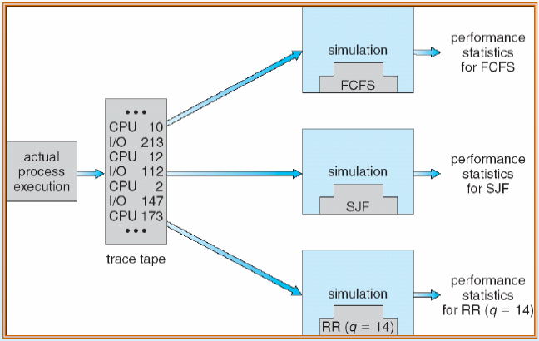
Simulations
PPTs from others\www.cs.gsu.edu_~cscbecx\csc4320 Chapter 5-3.ppt

Slide 69
Simulation - Queuing models
Queuing models [排队模型]
Queueing-network analysis
The computer system is described as a network of servers. Each server has a queue of waiting process. The CPU is a server with its ready queue, as is the I/O system with its device queues.
Knowing arrival rates and service rates, we can compute utilization, average queue length, average wait time, and so on.
Useful for comparing scheduling algorithms. But real distributions are difficult to work with, and some assumptions required.
Power of mathematics – this is the general way to find solutions for problems
PPTs from others\OS PPT in English\ch06.ppt

